Slide 1
Lab 4: Model Calibration and Uncertainty Analysis
May 26, 2020

Slide 2
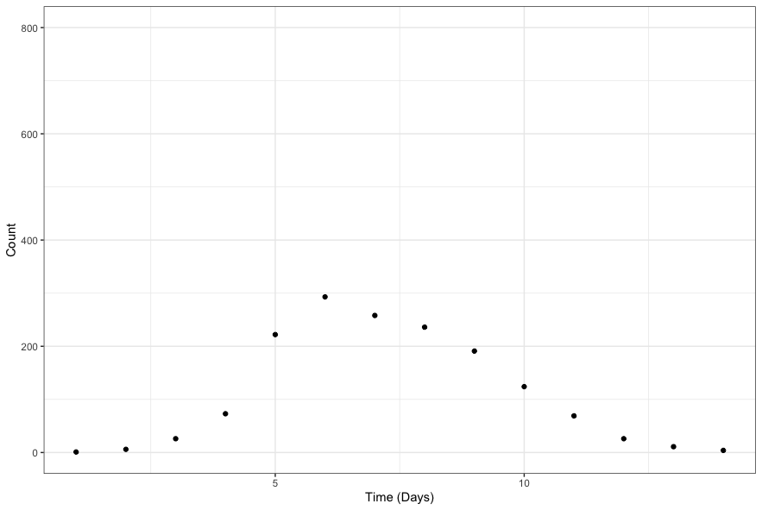
Parameter Estimation

Slide 3
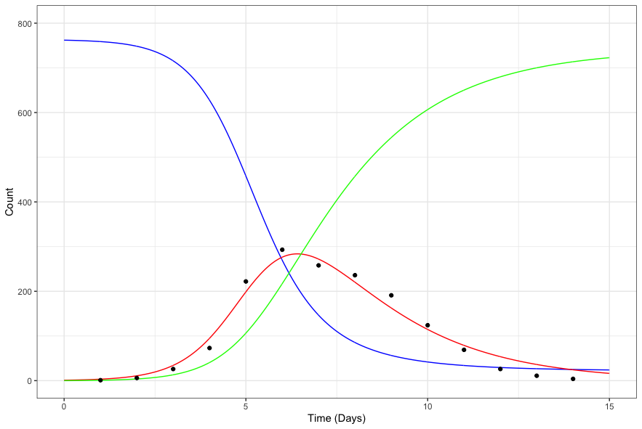
British Boarding School Model Fit

Slide 4
S
βSI
I
γΙ
R
infection
recovery
What values of β and γ generated this outbreak?

Slide 5
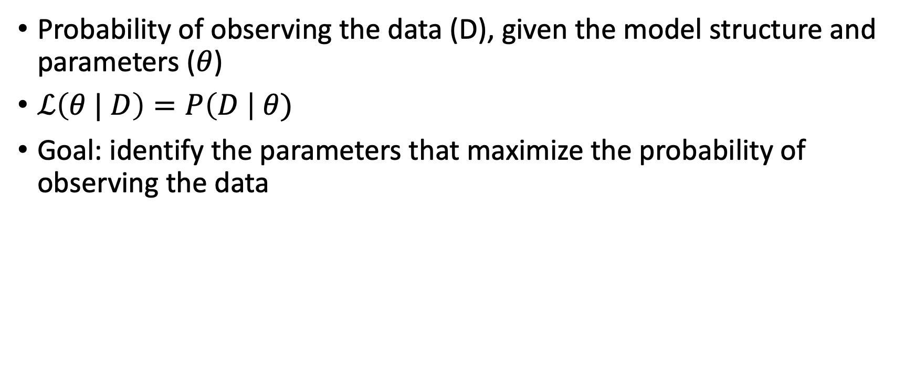
Likelihood
Probability of observing the data (D), given the model structure and parameters ($θ$)
$ℒ\left(θ | D\right)=P\left(D \right| θ)$
Goal: identify the parameters that maximize the probability of observing the data

Slide 6
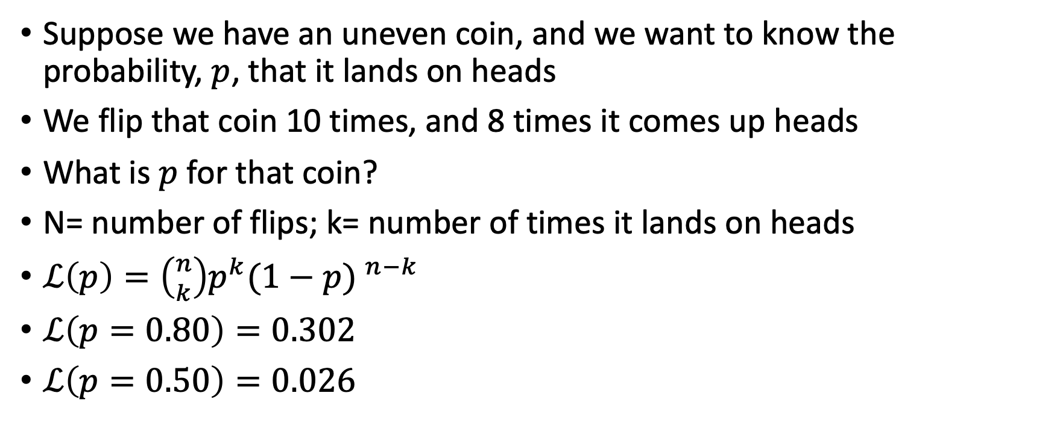
Likelihood Example
Suppose we have an uneven coin, and we want to know the probability, $p$, that it lands on heads
We flip that coin 10 times, and 8 times it comes up heads
What is $p$ for that coin?
N= number of flips; k= number of times it lands on heads
$ℒ\left(p\right)=\left({n \atop k}\right)p^{k}{(1−p) }^{n−k}$
$ℒ\left(p=0.80\right)=0.302$
$ℒ\left(p=0.50\right)=0.026$

Slide 7
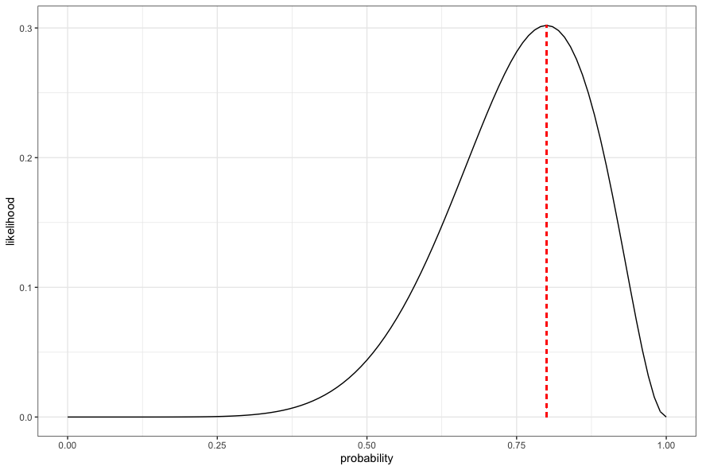
Likelihood Continued

Slide 8
Likelihood Continued
What if we flipped the coin 100 times, and 80 times it was positive?

Slide 9
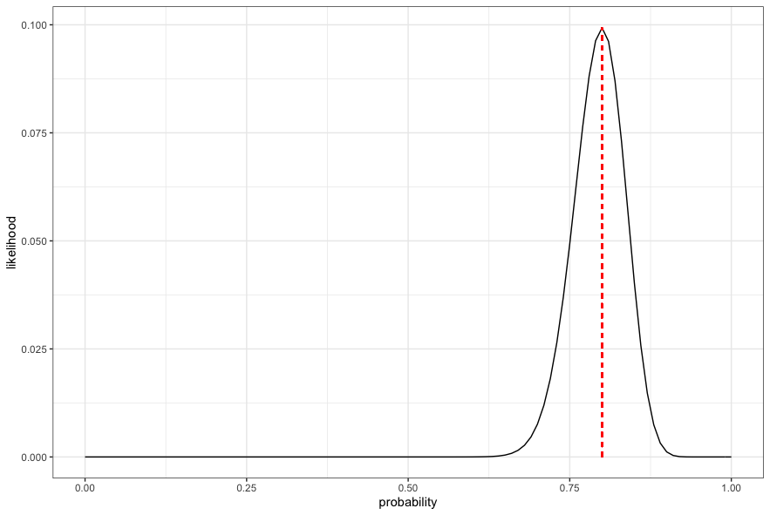

Slide 10


Parameter Estimation in SIR Models
$$ℒ\left(θ | D\right)=P\left(D \right| θ)$$
$$ℒ\left(θ | D\right)=P\left(D_{1} \right| θ)∗P\left(D_{2} \right| θ)$$
$$∗P\left(D_{3} \right| θ)∗ … P\left(D_{n} \right| θ)$$

Slide 11
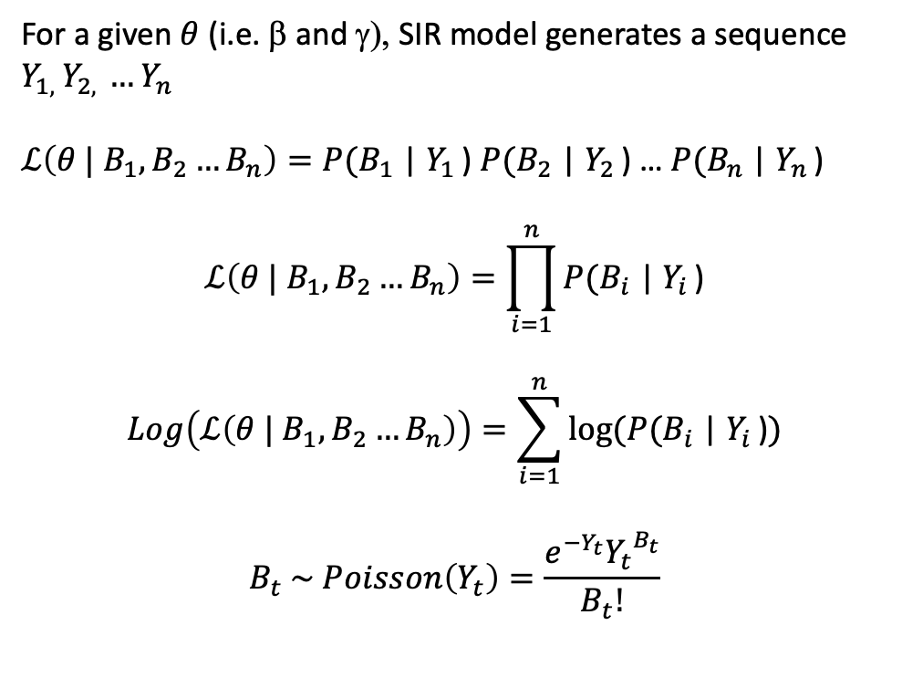
For a given $θ$ (i.e. β and γ), SIR model generates a sequence $Y_{1, }Y_{2, }…Y_{n }$
$ℒ\left(θ | B_{1},B_{2}…B_{n}\right)=P(B_{1}$ | $Y_{1 }$) $P(B_{2}$ | $Y_{2 }$) … $P(B_{n}$ | $Y_{n }$)
$$ℒ\left(θ | B_{1},B_{2}…B_{n}\right)=\prod_{i=1}^{n}{P(B_{i}\text{ |} Y_{i }\text{)}}$$
$$Log\left(ℒ\left(θ | B_{1},B_{2}…B_{n}\right)\right)=\sum_{i=1}^{n}{log⁡(P(B_{i}\text{ |} Y_{i }\text{)})}$$
$$B_{t} \sim Poisson\left(Y_{t}\right)=\frac{e^{−Y_{t}}{Y_{t}}^{B_{t}}}{B_{t}!}$$
Assume that observed cases (B) arise from Y in XYZ (SIR) model
B
X
βSY
Y
γY
Z
infection
recovery

